Slide 1


Crime Rates Prediction
By Georgy Zedgnidze & Viktor Zaharchenko

Slide 2
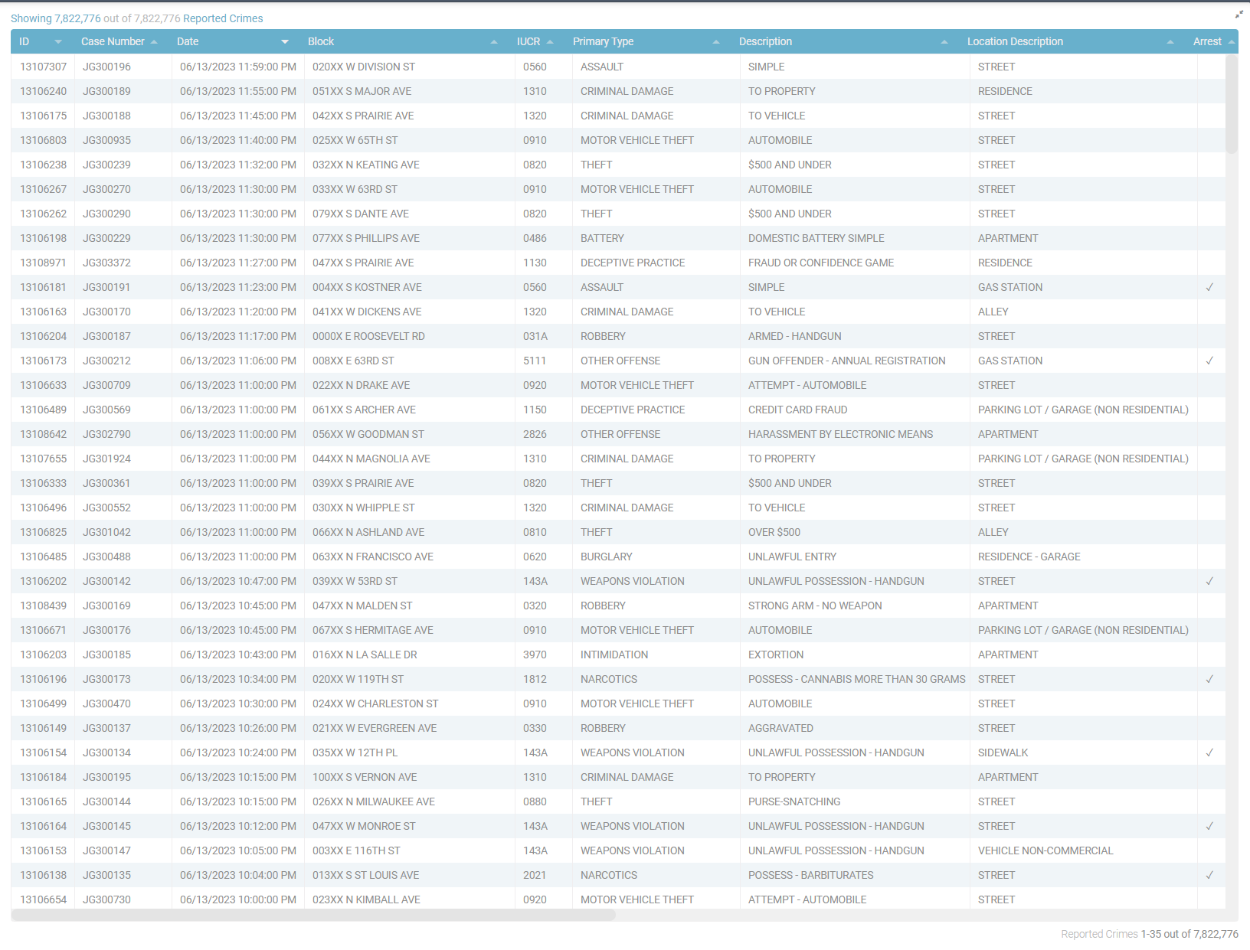
Crawling:
https://data.cityofchicago.org/Public-Safety/Crimes-2001-to-present-Dashboard/5cd6-ry5g
Webpage Scrolling
Dynamic table
Collecting data with Selenium

Slide 3

Data Analyzing
Creating the Data Frame – Each Row represents a crime
Cleaning “Unknown”/missing data
Converting time into simple hours
Transforming GPS coordinates/Absolute locations into simple locations
Managing locations into Coordinal directions

Slide 4
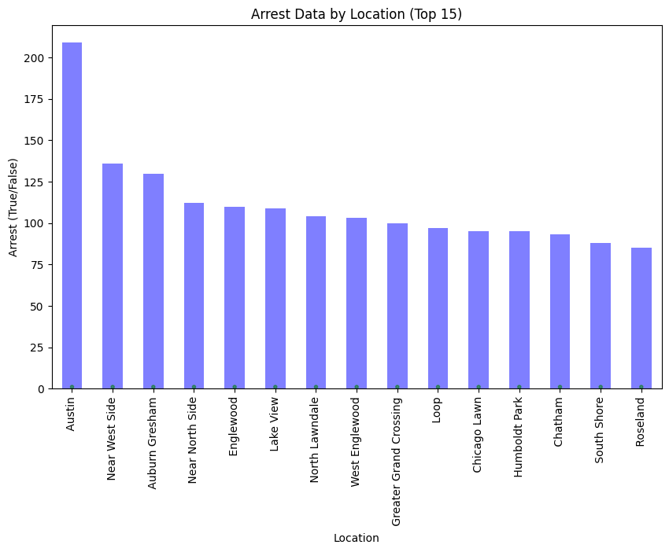
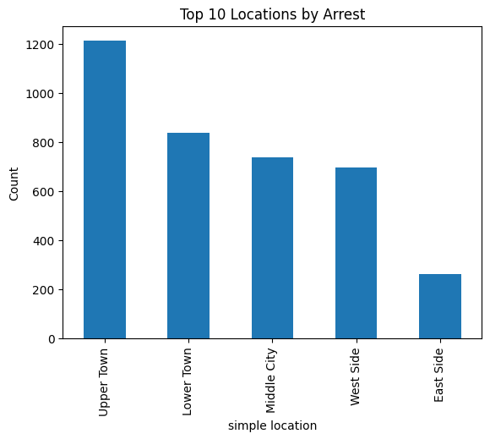
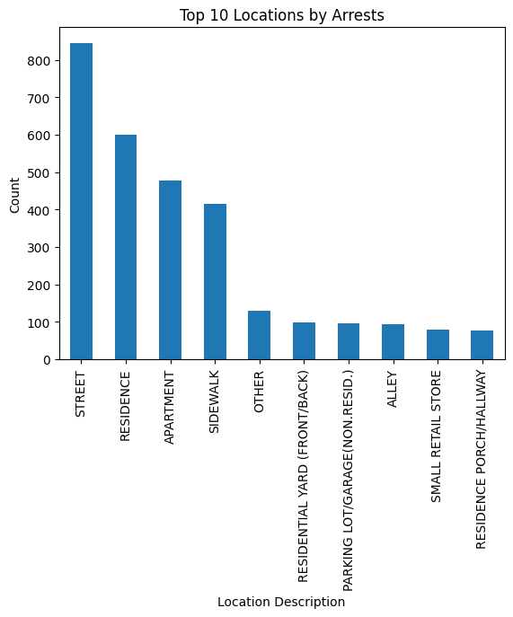
Visualization & EDA
Crime location - Arrest

Slide 5
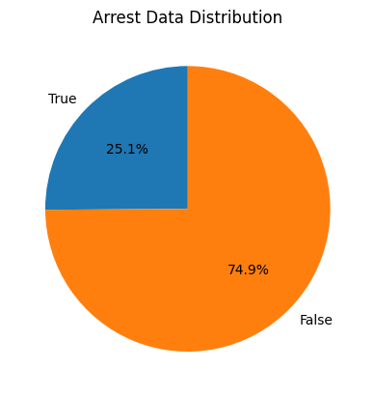
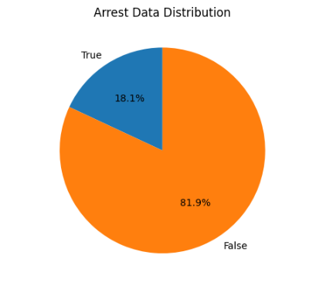
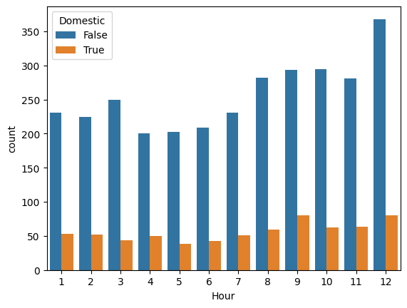
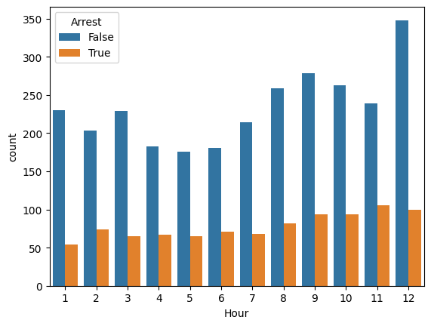
Visualization & EDA
Arrest ration – Domestic ratio

Slide 6
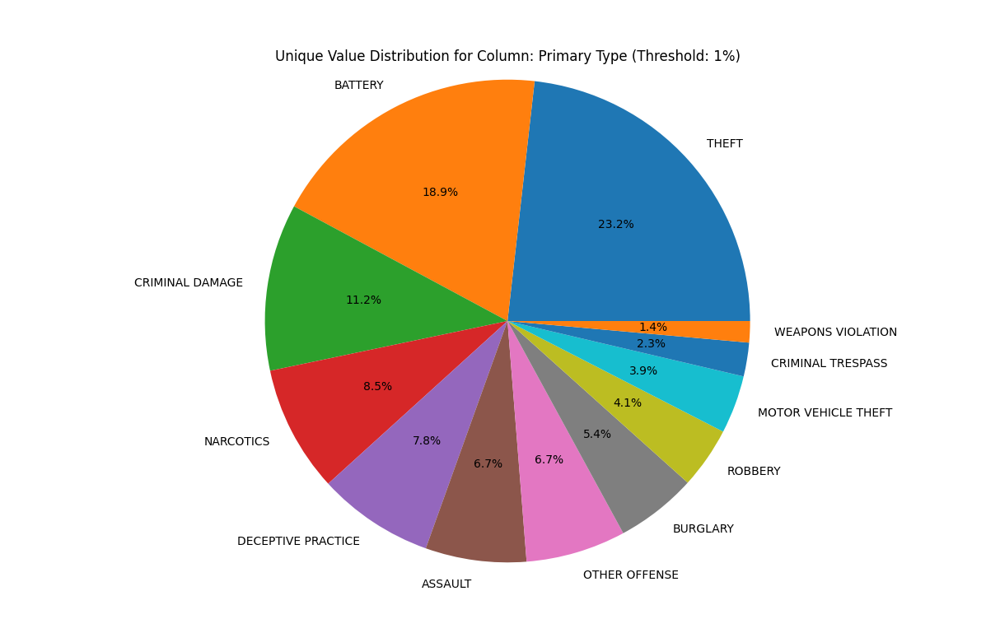
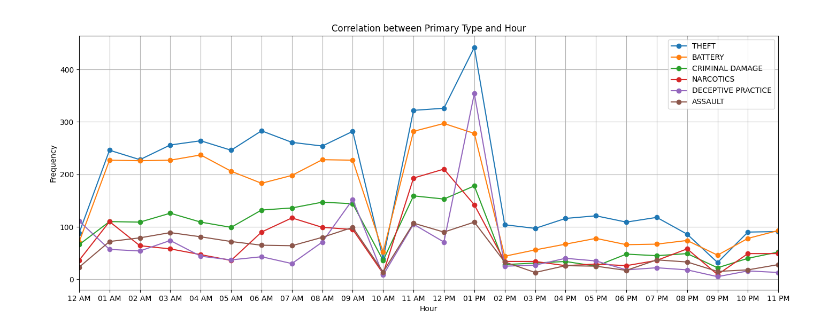
Visualization & EDA

Slide 7
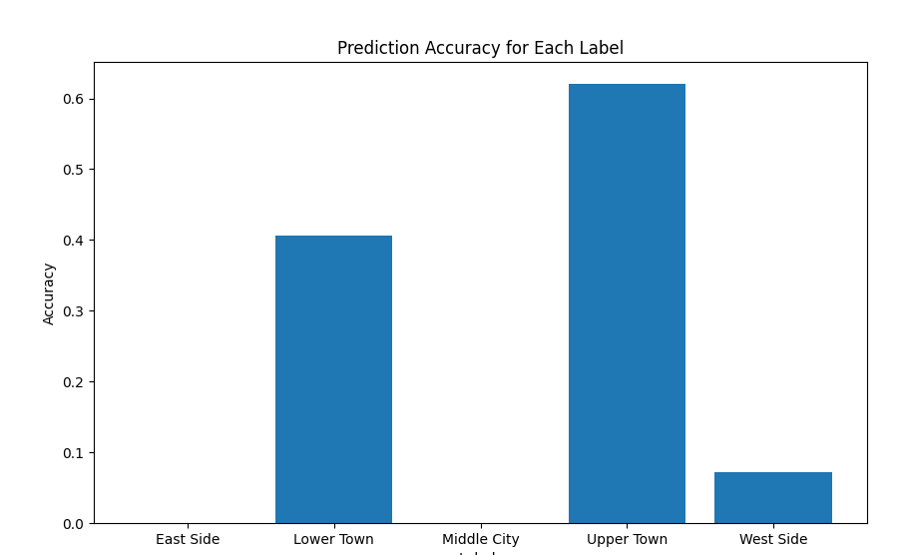
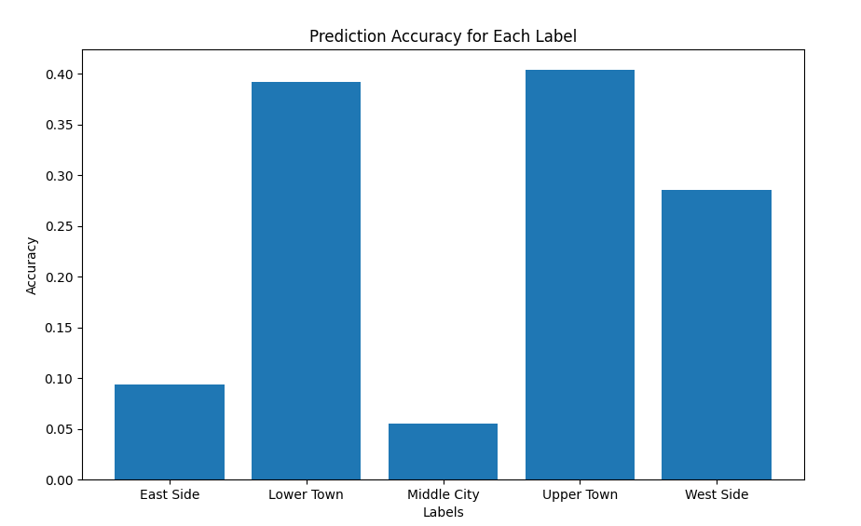
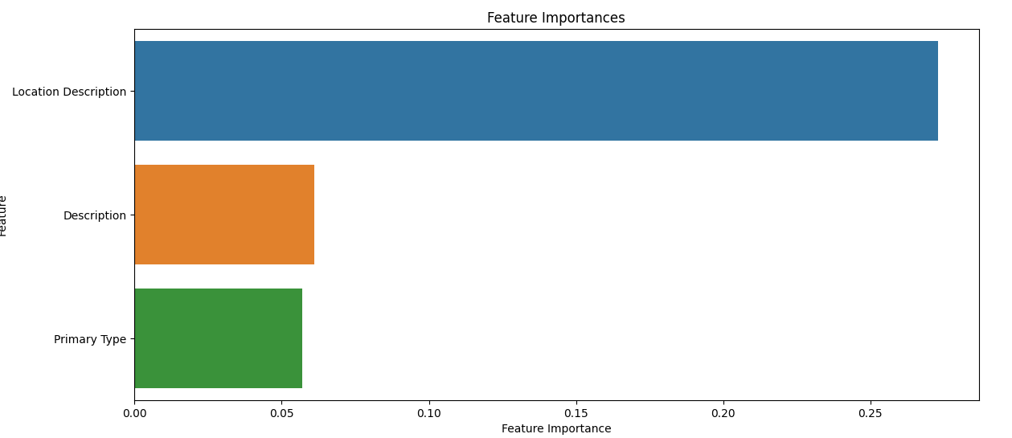
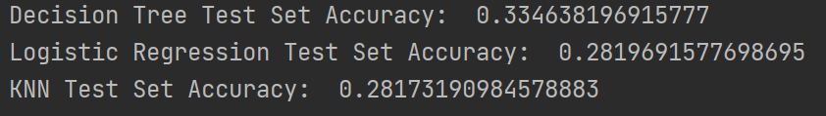
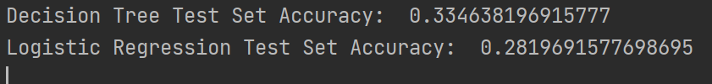
Machine Learning
Decision Tree
Logistic Regression
KNN
Converting textual data into numeric data
Fitting
Accuracy between Decision Tree – KNN – Logistic Regression
Visualization
Data impact

Slide 8
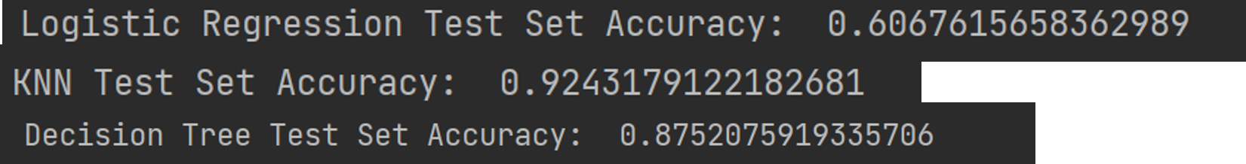
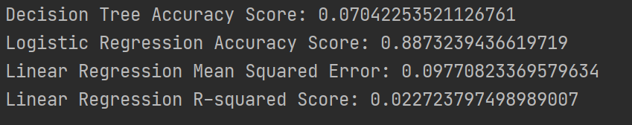
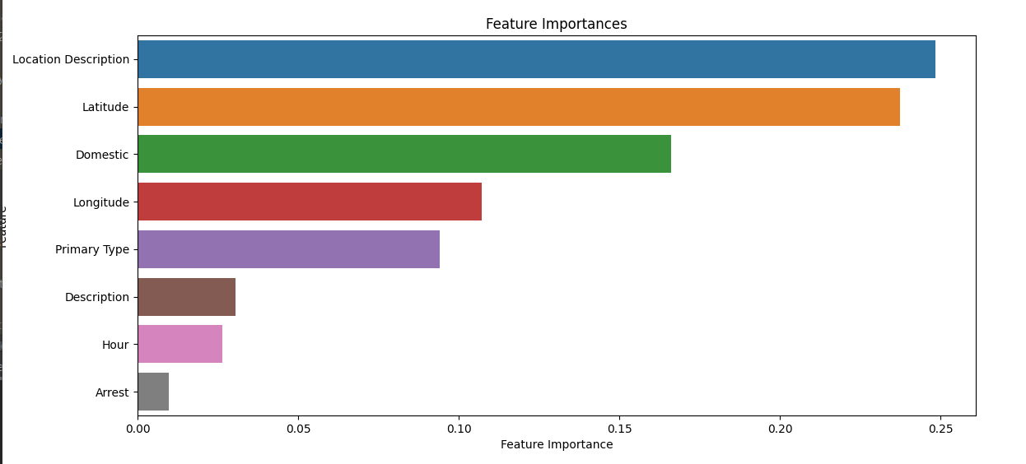
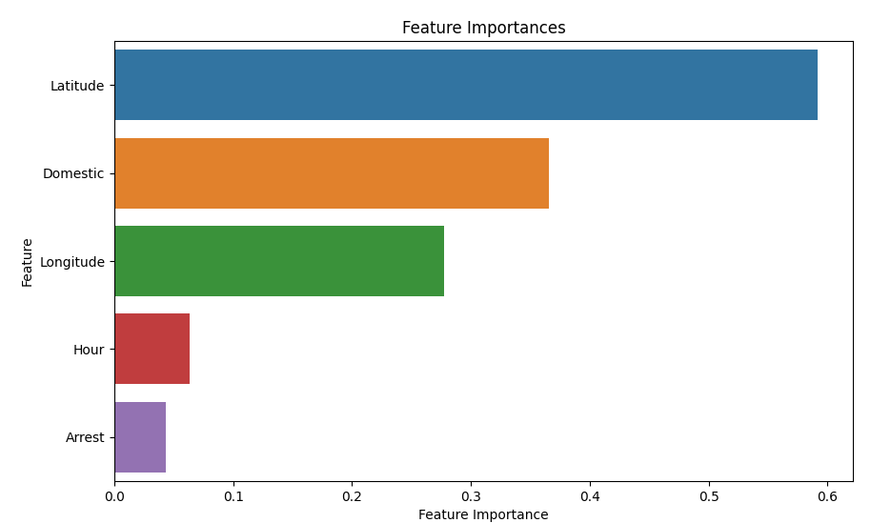
Machine Learning Improvements
Better Data Categorization
Data fitting – Turning certain textual data to numeric

Slide 9
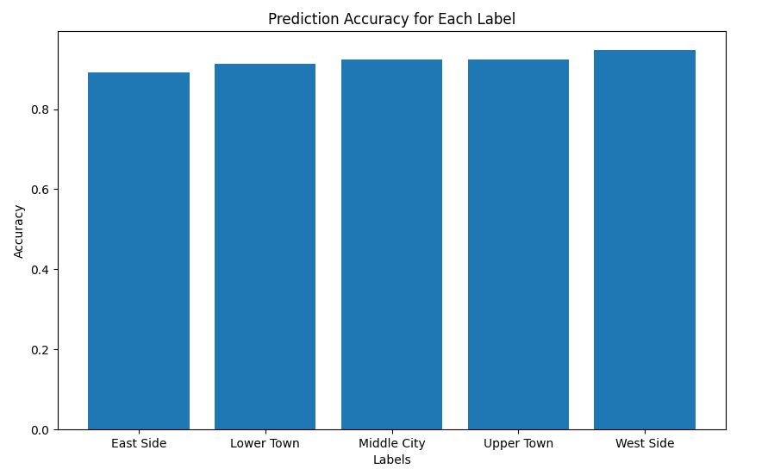
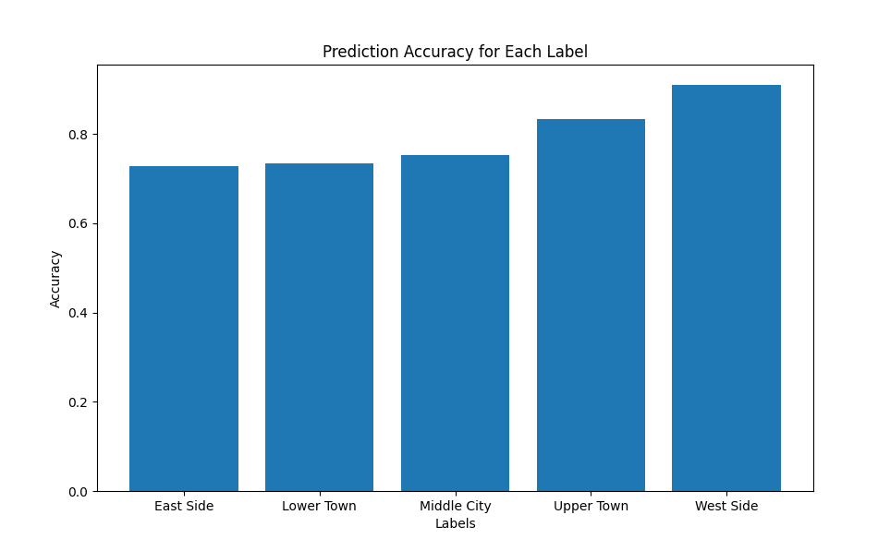
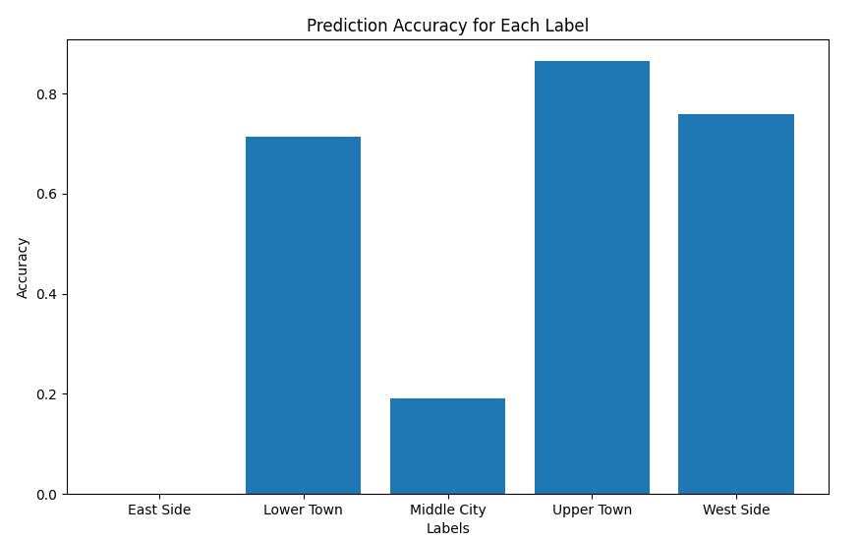
Machine Learning Visualization

